Slide 1
Identifying implicit bias in Letters of Recommendation
Purpose: Recognizing implicit bias in recommendation letters reduces the impact of that bias on our judgement of applicants’ qualities.

Slide 2
Why did we organize this workshop?
Notes:
Acknowledge: Nanticha Lutt, Dhruv Patel, Tiffany Lowe-Power; Karie Frasch; Retreat committee

Slide 3
Why did we organize this workshop?
In academia, we frequently receive and write letters of recommendation and get them written about us. These letters should reflect the abilities and competency of the applicants for the job and not be obscured by biases we don’t fully recognize.
Studies indicate: Being aware of implicit bias in letters before evaluating candidates reduces the impact of the bias!

Slide 4
Why did we organize this workshop?
“Recommendation letters play a key role in academic selection processes, as they contribute to the overall perception of a candidate’s ‘fit’ for a position and often provide the first impression of the applicant. Further, recommendation letters offer personal information about the candidate, and due to the subjective nature of these letters, the biases of the writer are more likely to surface.”
Madera, J., Hebl, M. & Martin, R. Gender and letters of recommendation for academics: agentic and communal differences. J. Appl. Psychol. 94, 1591–1599 (2009).

Slide 5
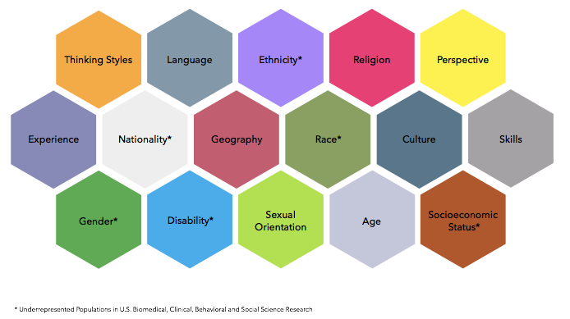
Most implicit bias / letters of recommendation studies focus on gender (benefits of sample size), but implicit bias affects other under-represented groups too.

Slide 6
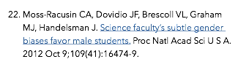
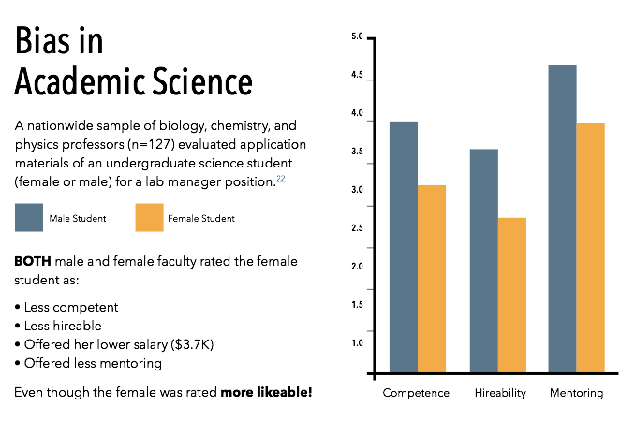
Applicants were scored on a 1-5 scale, with 5 being highest.
Score
Notes:
Reformat this highest score or lowest score

Slide 7
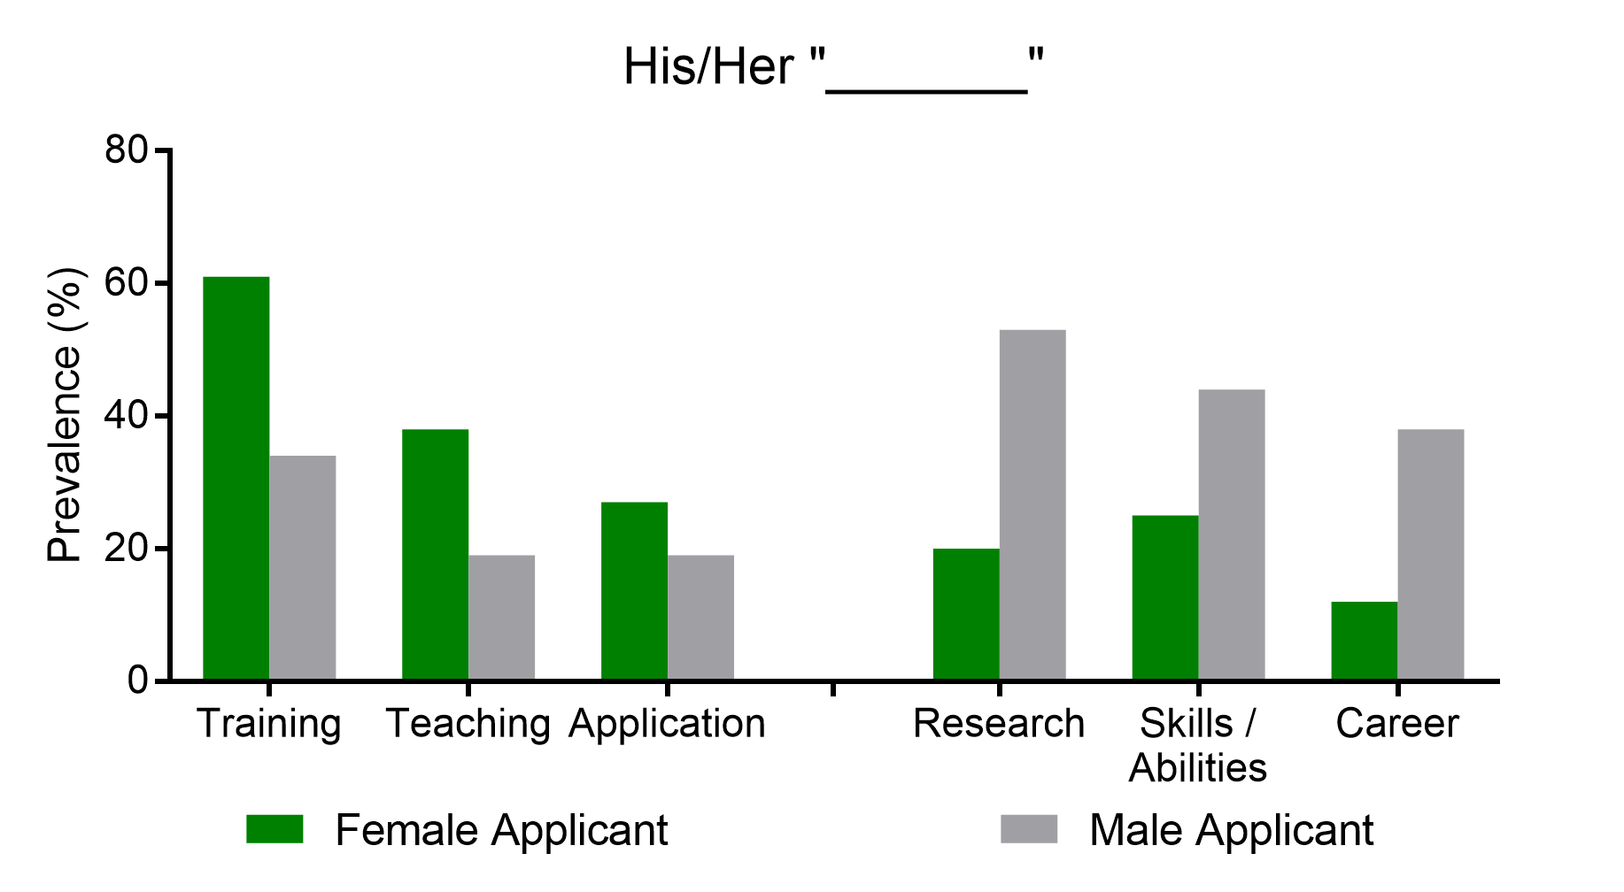
One example of Implicit Bias: Women are portrayed as students and teachers. Men are portrayed as professionals and researchers.
Trix & Psenka, 2003
Notes:
X-axis indicates the # word category that followed his/her in letters of recommendation. ~Pg 211 of Trix and Psenka

Slide 8
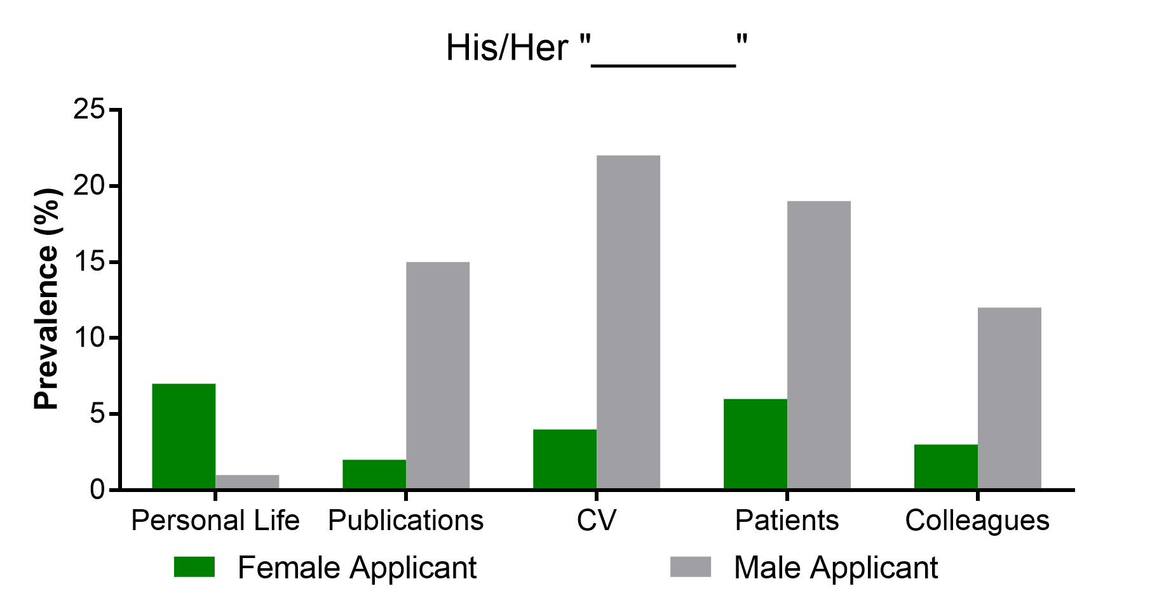
Subtle Implicit Bias: Letters for women are more likely to mention personal life, less likely to mention important details like career accomplishments
Trix & Psenka, 2003
Notes:
X-axis indicates the # word category that followed his/her in letters of recommendation. ~Pg 211 of Trix and Psenka

Slide 9
Useful things to know
Female and male letter writers show equal implicit bias against women
Implicit bias can take many forms (including wrong things, overlooking right things):
Mentioning “personal life”
More emphasis on effort than accomplishment
More “grindstone” adjectives, e.g. hardworking, dilligent, conscientious, dedicated
Less emphasis on important qualifications (research and publications)
Shorter letters or...
More emphasis on teaching, service (especially service to empower under-represented groups)
Less repetition of standout words
‘excellent’, ‘superb’, ‘outstanding’, ‘unique’, ‘exceptional’, and ‘unparalleled’
More doubt raisers/hedges
Notes:
Revise this to include the terminology from the trix paper

Slide 10
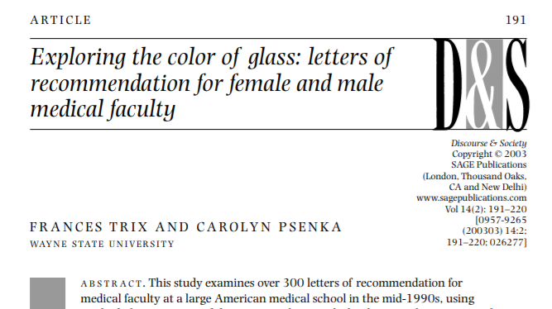
Break-out Activity: Read letters, Identify/Discuss biases, Share
Source of letters of recommendation: Trix & Psenka 2003
All content originated in real letters of recommendation written for male/female candidates that successfully obtained faculty positions at a medical school.
Trix & Psenka anonymized names & institutions printed excepts & full-length letters that demonstrated categories of implicit bias. We only made cosmetic changes as we merged some of the examples.

Slide 11
Break-out Activity: Read letters, Identify/Discuss biases, Share
teaching, service (Over-emphasizing)
https://goo.gl/UCoQhR
research and publications
standout words
accomplishment
effort / grindstone adjectives
personal life
doubt raisers/hedges

Slide 12
Identifying implicit bias in Letters of Recommendation
Large Group Discussion

Slide 13
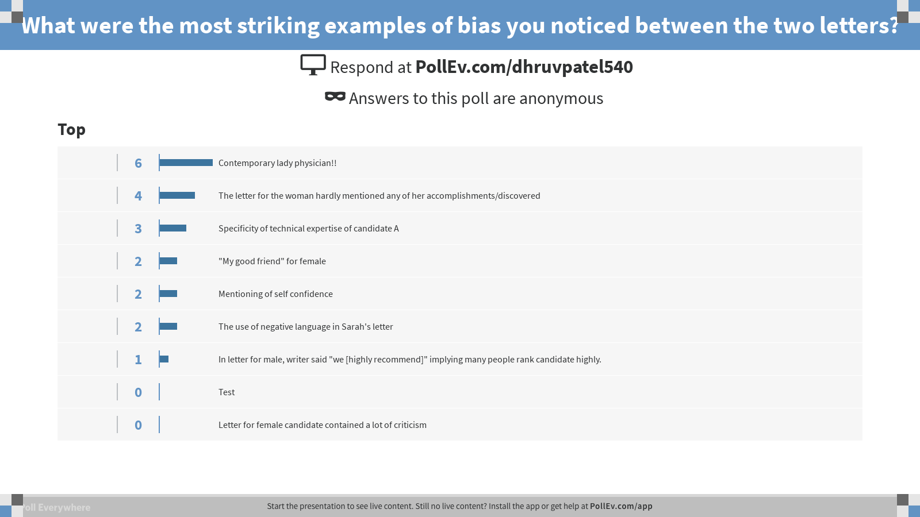
Notes:
Poll Title: What were the most striking examples of bias you noticed between the two letters? https://www.polleverywhere.com/discourses/v1OSFZr2KM0qbUl

Slide 14
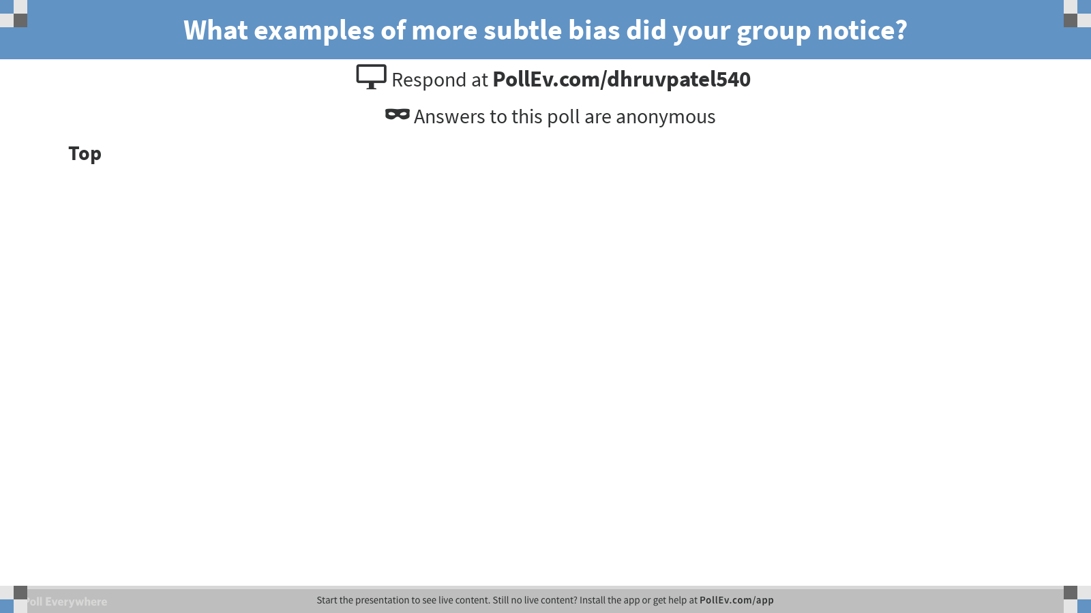
Notes:
Poll Title: What examples of more subtle bias did your group notice? https://www.polleverywhere.com/discourses/3eWAZwd7g7xPlQn

Slide 15
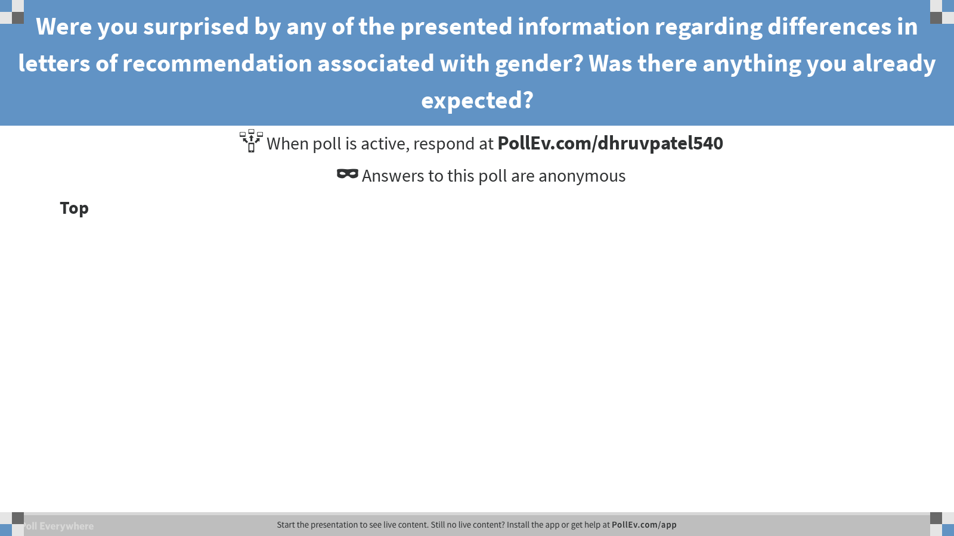
Notes:
Poll Title: Were you surprised by any of the presented information regarding differences in letters of recommendation associated with gender? Was there anything you already expected? https://www.polleverywhere.com/discourses/jxtx63QPo47mu3o

Slide 16
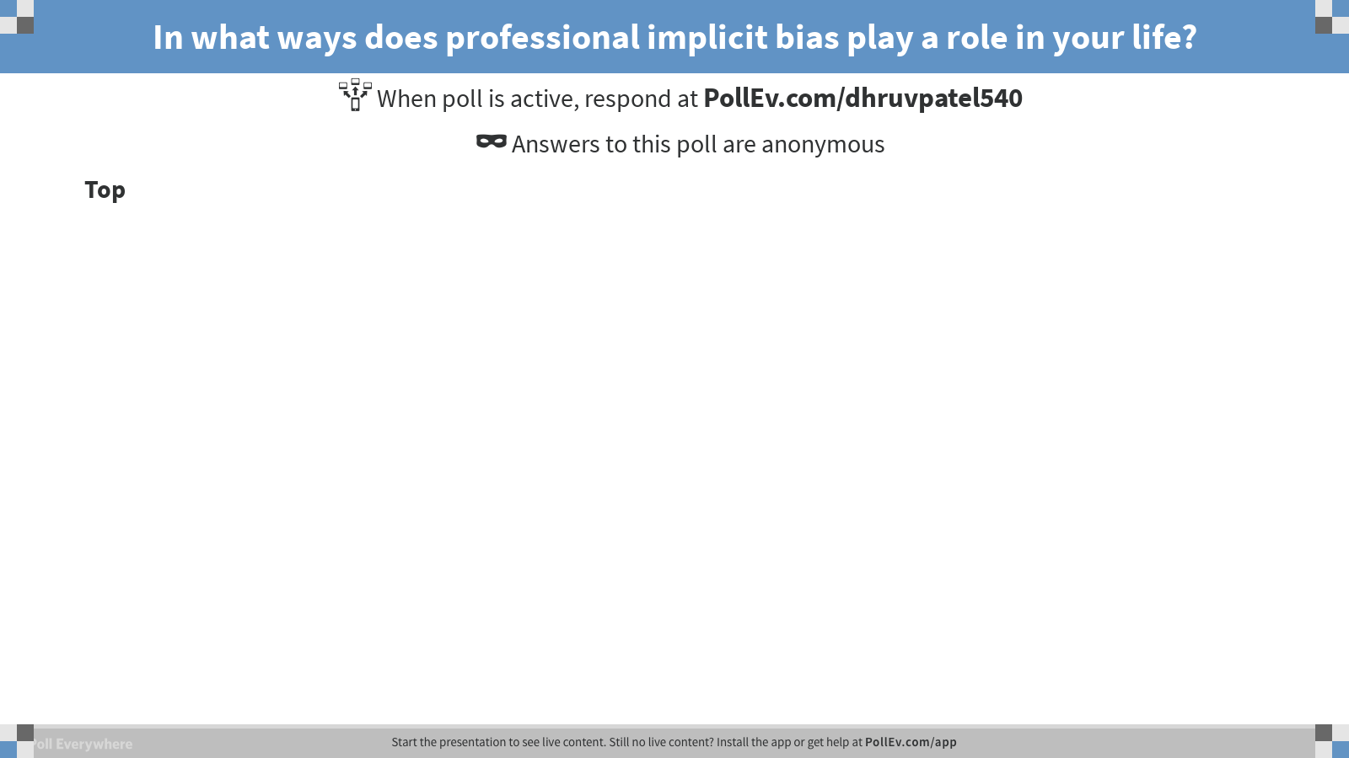
Notes:
Poll Title: In what ways does professional implicit bias play a role in your life? https://www.polleverywhere.com/discourses/cd3E2Ab8xBRuoqI

Slide 17
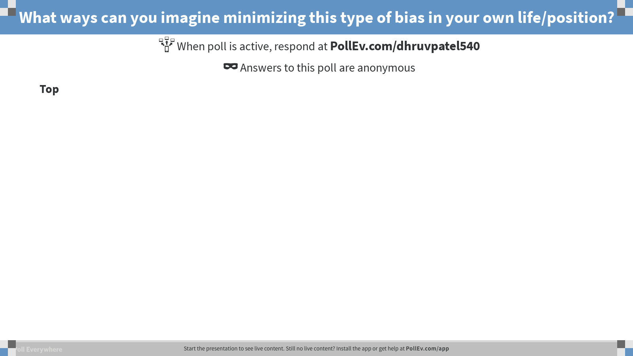
Notes:
Poll Title: What ways can you imagine minimizing this type of bias in your own life/position? https://www.polleverywhere.com/discourses/Rx2hzNP9L1DMXS7

Slide 18
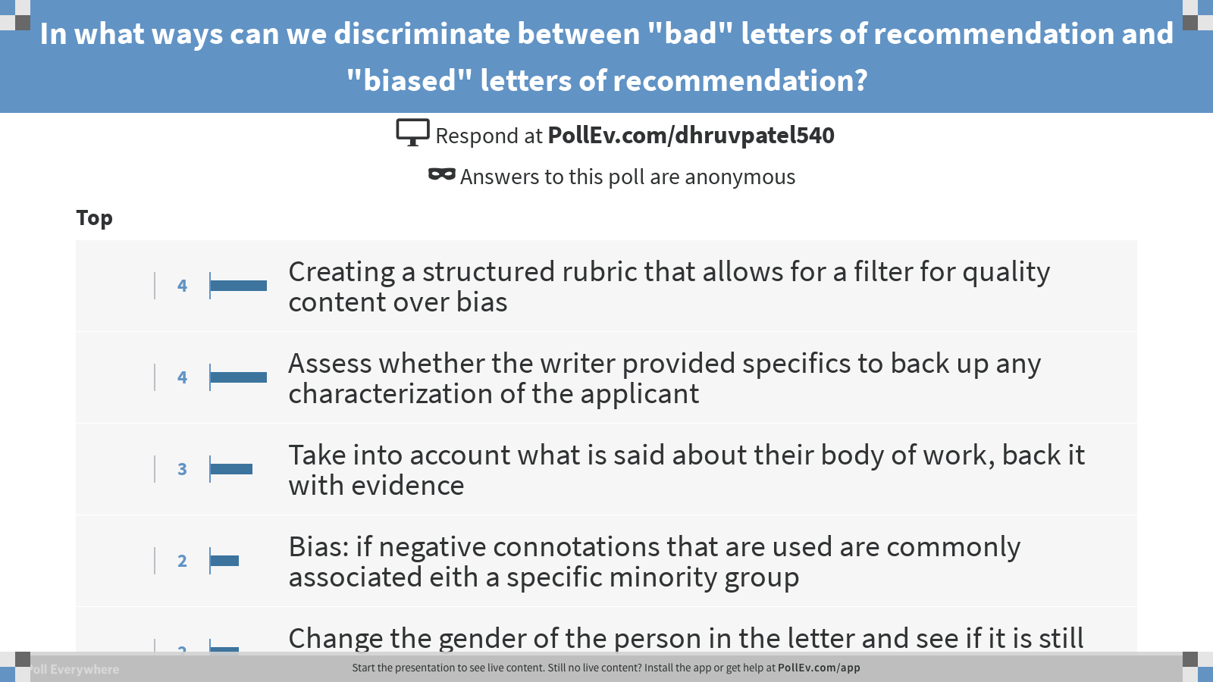
Notes:
Poll Title: In what ways can we discriminate between "bad" letters of recommendation and "biased" letters of recommendation? https://www.polleverywhere.com/discourses/xF3Ppso2sVaa4Hp

Slide 19
What are concrete ways we can reduce implicit bias when considering letters of recommendation?
Establish a detailed rubric to evaluate supplied materials.
If possible, review and score example materials as a group, to standardize how letters are evaluated.
Read candidate-supplied materials first so that letters do not overly color your initial impressions. Rate the application and review the letters at a second stage.
Ask committee members to use concrete evidence in their decision to not move a candidate forward - avoiding gut feelings that may be unintentionally rooted in bias.
Question whether “doubt raisers” in letters match up with the rest of the application, or seem at odds with the overall assessment.
Contact letter writers to ask for elaboration on their evaluation of the candidate when there is concern about the possibility of bias in the letter.
Review women and URM candidates a second time if there is concern that the evidence is not clear to move them forward, or not.

Slide 20
Thank you for your participation!

